Slide 1


Digital Forensics
AegisForensics
AI-Powered Digital Evidence Analyzer
Mohammed Salman Hyder 160923733227
Mohammed Nuzair Ilyas Siddiq 160923733196
Mohammed Shahnawaz Khan 160923733192
Shaik Muti Ur Rahman 160923733218

Slide 2
Introduction to Digital Forensics
Digital forensics is the process of collecting, examining and analyzing digital evidence to understand a cyber incident.
Modern cyberattacks can involve:
Ransomware
Credential theft
Privilege escalation
Persistence mechanisms
Lateral movement
Data exfiltration
Malware deployment
Investigators may need to examine different types of evidence:
Disk images
Memory dumps
event logs
Browser artifacts
Network captures
Malware samples
Active Directory information
Why is it difficult?
The evidence comes from many different sources and often requires different forensic tools.
Traditional investigations may involve tools such as:
Autopsy
FTK Imager
Volatility
Wireshark
YARA
Custom scripts
The investigator then has to manually combine the results.
AegisForensics: AI-Powered Digital Evidence Analyzer
2

Slide 3
Problem Statement :
Massive Evidence Volume :
Investigators may have to analyze:
1.Large disk images
2.Memory dumps
3.Millions of log entries
4.Browser records
5.Network packets
6.Malware files
Important evidence can be hidden among large amounts of normal data.
Multiple Disconnected Tools :
Different tasks require different tools. For example:
1. Volatility → Memory analysis
2. Wireshark → Network analysis
3. YARA → Malware/file detection
4. BloodHound → Active Directory analysis
The investigator must manually move between these tools.
Manual Correlation :
Evidence from different sources needs to be connected. For example:
Process execution → suspicious file → network connection → credential activity → persistence
Doing this manually can take significant time.
Timeline Reconstruction :
Different evidence sources have different timestamps. Investigators need to determine:
What happened first?
What happened next?
What happened during the attack?
Reporting Overhead:
After completing the investigation, technical findings must be converted into a readable report.
2

Slide 4
Literature Survey
Study | Focus | Research Gap
Solanke & Biasiotti (2022) | AI and ML for digital evidence identification and analysis | Does not establish a complete integrated forensic investigation workflow.
Stoykova & Franke (2023) | Reliability Validation Enabling Framework (RVEF) | Focuses on reliability and validation rather than automated evidence analysis.
Dunsin et al. (2024) | AI and ML for digital forensics and incident response | Identifies AI applications and challenges but does not provide a unified practical implementation.
Khalid, Iqbal & Fung (2024) | Explainable AI framework using LIME and SHAP | Focuses on explainability, leaving scope for broader integration with forensic analysis tools.
Sharma et al. (2025) | Local LLM fine-tuning and Retrieval-Augmented Generation (RAG) for forensic assistance. | Focuses on LLM-based assistance rather than a complete forensic evidence management workflow.
RESEARCH GAP
PROPOSED IMPROVEMENT
While existing studies address individual challenges in digital forensics, the reviewed approaches highlight the need for an integrated platform combining these capabilities.
An integrated platform combining automated evidence analysis, AI-assisted investigation, local LLM processing, cryptographic hashing, chain-of-custody documentation, and understandable forensic reporting.

Slide 5

Proposed Solution: One Unified Platform
End-to-end workflow
1. Evidence Acquisition
Collect and ingest different forms of digital evidence.
3. Forensic Analysis
Analyze memory, malware, Windows artifacts, browser artifacts, Active Directory and network evidence.
2. Artifact Extraction
Extract useful files, metadata, logs and forensic artifacts.
Evidence
Extraction
Analysis
4. AI-Assisted Analysis
Gemma 3B converts structured findings into:
Executive summaries
Incident narratives
Technical findings
Threat explanations
Recommendations
5. Threat Detection
Identify:
IOCs
IOAs
Suspicious patterns
Malware indicators
Threat behaviors
6. Correlation and Report Generation
Combine findings into:
Super timeline
Threat relationships
MITRE ATT&CK techniques
Threat scores
AI Assistance
Detection
3
Report

Slide 6
Investigation Methodology
End-to-end processing pipeline from multi-source acquisition to investigator validation
PHASE 01
PHASE 02
PHASE 03
Evidence Acquisition
Extraction & Preprocessing
Forensic Analysis
Ingest raw disk images, memory dumps, system event logs, PCAP network captures, and mobile extractions.
Parse raw structures, extract file metadata, compute cryptographic hashes, and evaluate byte entropy distributions.
Execute automated engines in parallel: FTK Imager, Binwalk, YARA-X, Volatility 3, PCAP parsers, and mobile tooling.
PHASE 04
PHASE 05
PHASE 06
Threat Correlation
AI-Assisted Analysis
Review & Validation
Extract indicators of compromise (IOCs), reconstruct unified timelines, and map techniques to the MITRE ATT&CK framework.
Incorporate Gemma 3B locally to generate structured incident summaries, threat narratives, and technical report drafts.
Produce standardized, defensible documentation and targeted recommendations for mandatory human validation.
02

Slide 7
System Architecture
Frontend
1
React, Next.js, TailwindCSS,Nexus.js
Purpose: Handles the user-facing web interface using a modern, component-driven React framework.
Application Layer
2
Python processing and orchestration
Purpose: Manages the core backend logic, tool orchestration, and workflows.
Forensic Engines
3
FTK Image, Binwalk,String Engine,Grep Engine, YARA-X,Volatility 3,Network PCAP,Manual Scripting
Purpose: Analyzes artifacts, detects malware patterns, inspects memory dumps, and processes system log rules.
Correlation & Storage
4
SQLite,PostgreSQL
Purpose: Parses timestamped timeline events, enables interactive analysis, and stores relational logs securely.
AI Layer
5
Gemma 3B
Purpose: Integrates a compact, open-weights lightweight Large Language Model (LLM) to assist with automated analysis, summaries.

Slide 8


Technology Stack: Frontend & Core
React
Next.js
TailwindCSS
Interactive, reusable UI components
Application structure and routing
Responsive, consistent styling
5

Slide 9





AegisForensics
Forensic Analysis Stack
Volatility 3
YARA-X
FTK
Memory forensics: processes, hidden processes, DLLs, command lines, network connections, malware activity
Suspicious files and malware patterns
Partition / Storage Analyasis
String Engine
PCAP
Windows PE analysis
Packet Capture Analysis Program

Slide 10






AegisForensics
Network & Timeline Forensics Stack
Wireshark
Zeek
AndroidQF
Packets and PCAP files
Traffic into security logs and metadata
Mobile detection and extraction
PyShark
Deep carving
Timesketch
Python packet analysis and automation
File Carving, Mobile Analysis
Visualize the combined timeline
7

Slide 11
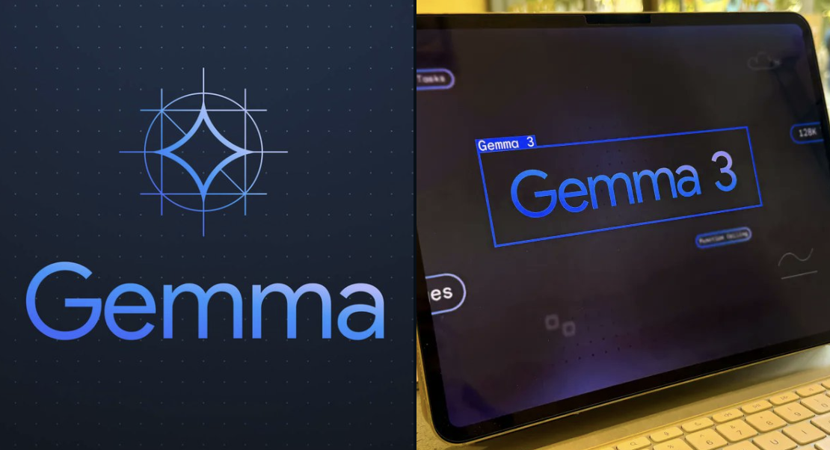
AegisForensics
Gemma 3B: Local AI Assistant
Executive summaries
Incident narratives
Technical findings
Threat explanations
Remediation recommendations
Draft forensic reports
It assists the investigator and does not replace forensic validation.
8

Slide 12
AegisForensics
The AI receives findings; it never decides what happened
1
2
3
4
5
6
Forensic Evidence
Analysis Results
Timeline + MITRE ATT&CK
Gemma 3B
AI-Assisted Report
Investigator Review
9

Slide 13
AegisForensics
Expected Output
What the investigator finally gets from the system
Investigator Dashboard
Forensic Findings
AI-Assisted Report
Case information
Evidence status
Indicators
Threat score
Timeline
Extracted artifacts
Memory findings
Malware indicators
Network events
Active Directory findings
MITRE ATT&CK mappings
Executive summary
Incident narrative
Technical findings
Threat explanation
Recommendations
Notes:
The final output is not just raw forensic data. The investigator gets a centralized dashboard, structured forensic findings, a correlated timeline and an AI-assisted report.

Slide 14
AegisForensics
Conclusion & Future Scope
Conclusion
Future Scope
AegisForensics aims to:
Cloud deployment
Improved offline/local LLM capabilities
Live endpoint acquisition
SIEM integration
SOAR integration
EDR integration
ML-based anomaly detection
Collaborative investigations
Reduce manual forensic work
Unify multiple forensic technologies
Improve evidence correlation
Assist threat investigation
Generate understandable reports
Notes:
In conclusion, AegisForensics combines digital forensic tools with automation and Gemma 3B to create a unified investigation platform. In the future, it can be extended with SIEM, SOAR, EDR, cloud deployment and machine-learning capabilities.

